Slide 1
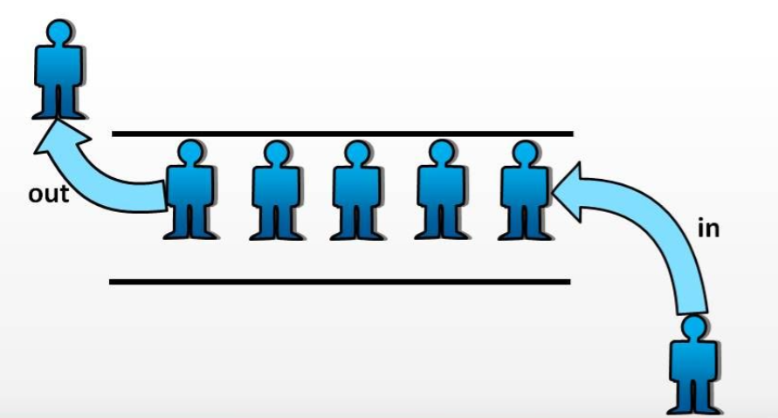

Slide 2
Queue
Mohammad Shahid Qureshi

Slide 3

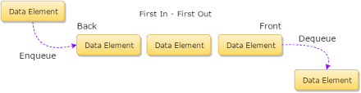
Queue Data Structure
The queue data structure implements the well known queue concept present in our daily life, e.g., queue at bank
Dealing with data, we sometimes want to create queues of data to know which data came first.

Slide 4
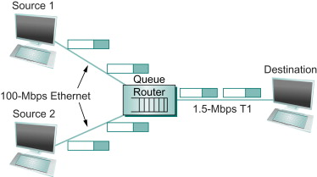
Need for Queues for data
Communication Software
  queues to hold information(packets) received over internet links on routers/computers
    (Information is received faster than it can be processed, so is placed in a queue waiting to be processed)
Operating system
  multi-user/multitasking environments, where several users or task may be requesting the same resource simultaneously

Slide 5
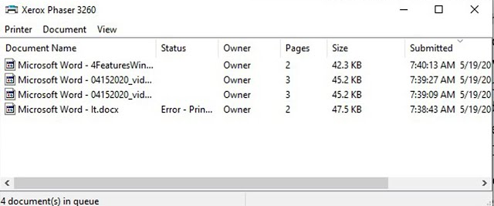
Printer
  If printer gets more than one printing requests, then it make a queue of these printing requests, and starts printing using “First come, First served” or FIFO

Slide 6
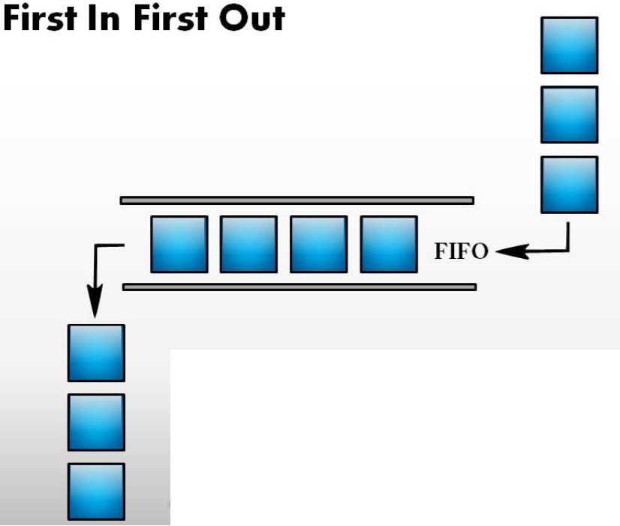
Queue
“A Queue is a linear data structure, where items are inserted at one end (the rear) And deleted at the other end (the front)”
Other Name:
First In First Out (FIFO)

Slide 7
Common Operations on Queues
(Queue ADT)
PUSH(x):
  Inserts element x at the end of Queue. Also known as Enqueue
POP():
  Deletes the first element of the Queue. Also known as Dequeue
FRONT():
  Returns the first element on Queue
ISEMPTY():
  Returns true if its an empty queue

Slide 8
Implementation
Array based
  Queue can be implemented by an array, and size of queue remains fix
Link List based
  A queue can be implemented as a linked list, and expand or shrink with each push or pop operation.

Slide 9
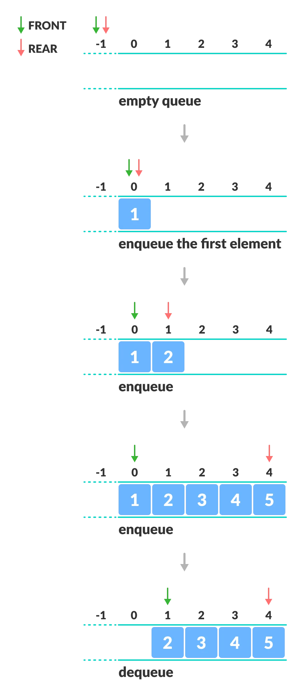
Array based implementation
Need two indexes to denote the front and end of queue
Problem: Memory wastage, as the empty array elements at the start of array not being used.
Solution: Shift elements left whenever delete an element

Slide 10
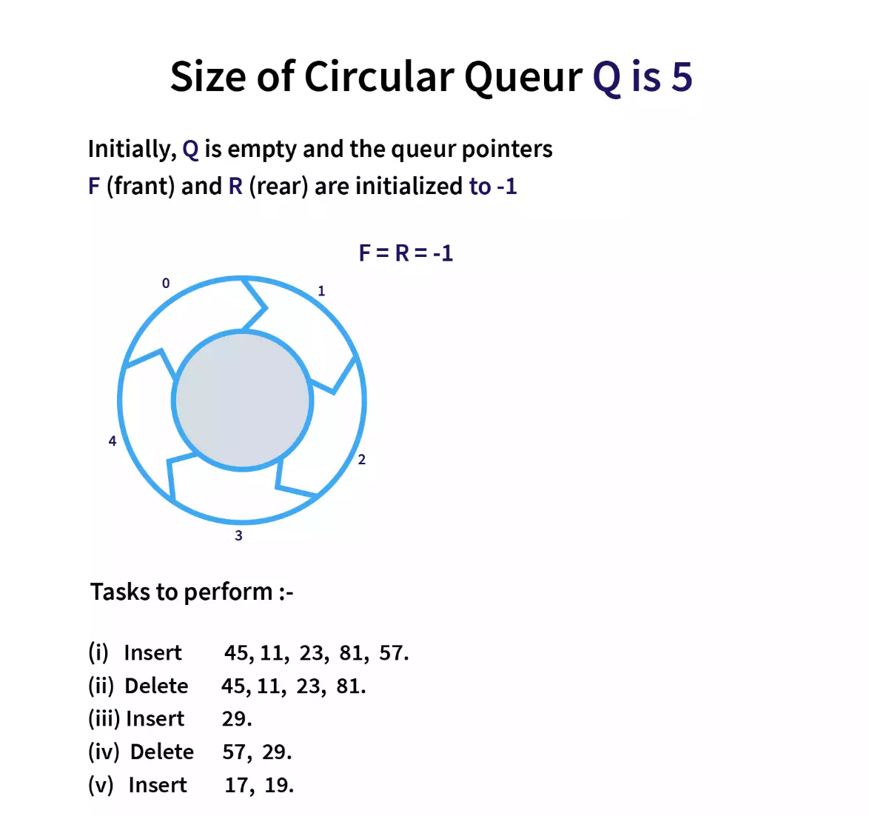
Circular Array implementation

Slide 11


Slide 12
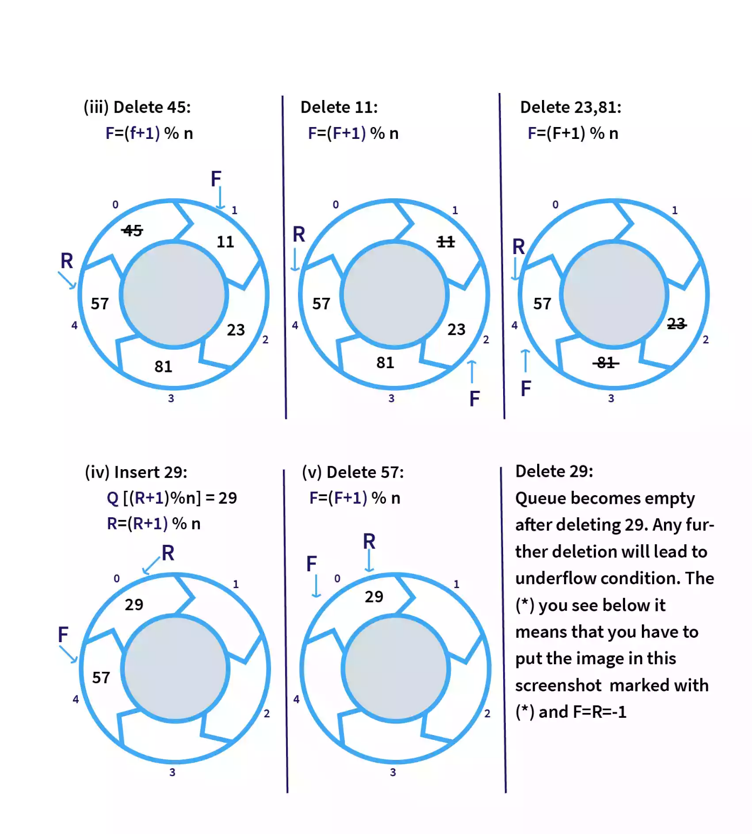

Slide 13
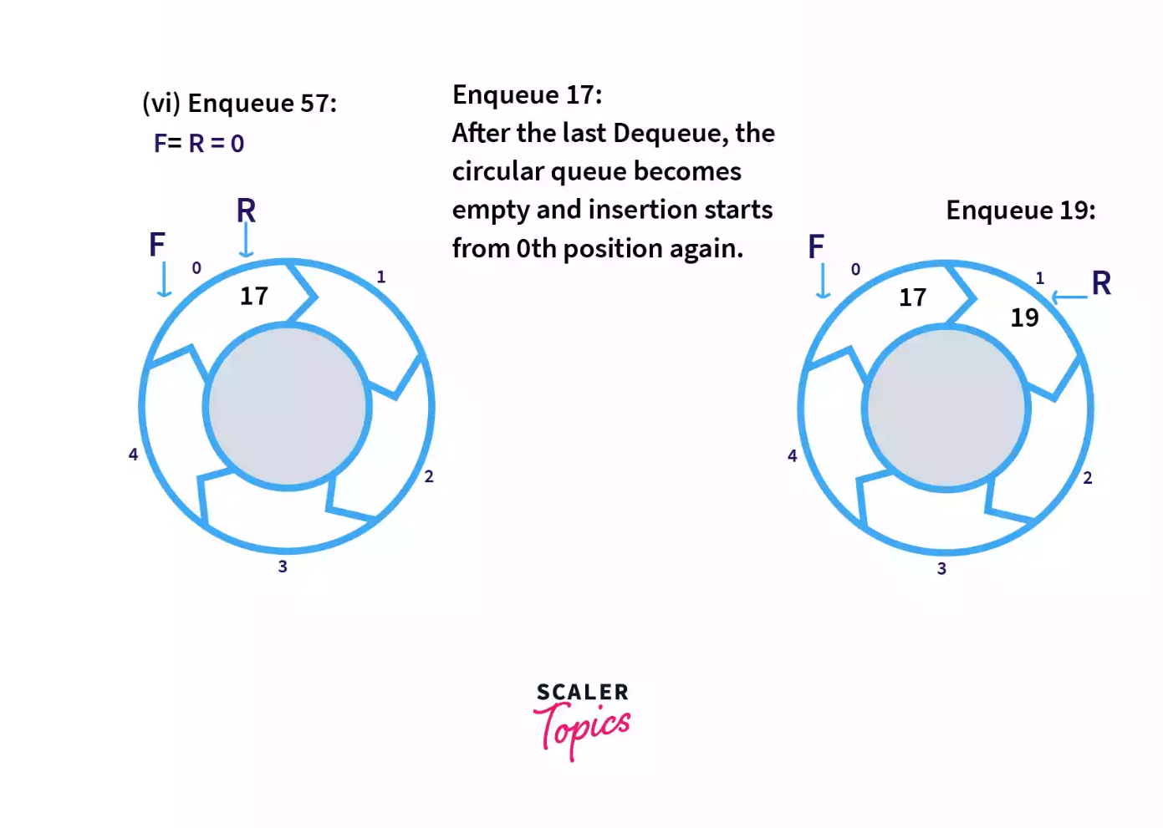

Slide 14
A pointer Implementation of Queues
Keep two pointers:
FRONT: A pointer to the first element of the queue.
REAR: A pointer to the last element of the queue.
.
Front
x
y
z
Rear

Slide 15
A pointer Implementation of Queues
Q.Front = NULL
Q.Rear = NULL
PUSH(x)
x
.
Q.front
Q.Rear

Slide 16
A pointer Implementation of Queues
PUSH(y)
x
y
.
Q.front
Q.Rear
POP()
y
.
Q.front
Q.Rear

Slide 17
A class for Dynamic Queue implementation
class DynIntQueue
{
private:
struct QueueNode
{
int info;
QueueNode *link;
};
QueueNode *front;
QueueNode *rear;
int numItems;
public:
DynIntQueue(void);
~DynIntQueue(void);
void push(int);
void pop(void);
int front();
bool isEmpty(void);
void makeNull(void);
};

Slide 18
Implemenaton
//************************
// Constructor *
//************************
DynIntQueue::DynIntQueue(void)
{
front = NULL;
rear = NULL;
numItems = 0;
}
//************************
// Destructor *
//************************
DynIntQueue::~DynIntQueue(void)
{
makeNull();
}

Slide 19
//********************************************
// Function enqueue inserts the value in num *
// at the rear of the queue. *
//********************************************
void DynIntQueue::push(int num)
{
QueueNode *newNode;
newNode = new QueueNode;
newNode->info = num;
newNode->link = NULL;
if (isEmpty())
{
front = newNode;
rear = newNode;
}
else
{
rear->link = newNode;
rear = newNode;
}
numItems++;
}

Slide 20
//**********************************************
// Function dequeue removes the value at the *
// front of the queue *
//**********************************************
void DynIntQueue::pop(void)
{
QueueNode *temp;
if (isEmpty())
cout << "The queue is empty.\n";
else
{
temp = front->link;
delete front;
front = temp;
numItems--;
}
}

Slide 21
//*********************************************
// Function isEmpty returns true if the queue *
// is empty, and false otherwise. *
//*********************************************
bool DynIntQueue::isEmpty(void)
{
if (numItems)
return false;
else
return true;
}
int DynIntQueue::front(void)
{
if (!isEmpty())
return front->info;
else
cout<<“Queue Empty”;
}

Slide 22
//********************************************
// Function makeNull dequeues all the elements *
// in the queue. *
//********************************************
void DynIntQueue::makeNull(void)
{
while(!isEmpty())
pop();
}

Slide 23
int main()
{
  DynIntQueue Q;
  Q.push(45);
  Q.push(55);
  Q.push(65);
  cout<<Q.front();
  Q.pop();
  cout<<Q.front();
  Q.pop();
  cout<<Q.front();
}

Slide 24
Program
// This program demonstrates the DynIntQeue class
void main(void)
{
DynIntQueue iQueue;
cout << “Pushing 5 items...\n";
// Push 5 items.
for (int x = 0; x < 5; x++)
iQueue.push(x);
// pop and retrieve all items in the queue
cout << "The values in the queue were:\n";
while (!iQueue.isEmpty())
{
int value;
value = iQueue.front();
cout << value << endl;
iQueue.pop();
}
}

Slide 25
Program Ouput
Pushing 5 items...
The values in the queue were:
0
1
2
3
4

Slide 26
Template Queue
The previous example of IntegerQueue can be easily converted into a template Queue, thus any kind of data can be stored in such a Queue.

Slide 27
Priority Queue
A priority queue allows entries to be retrieved according to some specified priority levels.
  The highest priority entry is removed first
  Entries with equal priority can be removed according to FIFO as queue.

Slide 28
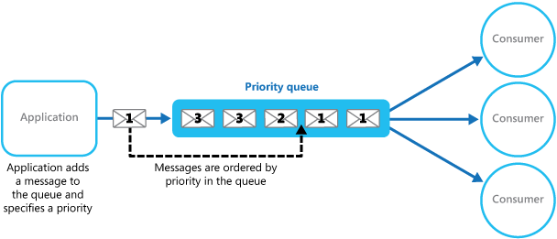

Slide 29
Reference
Chapter 8 – Queues
Push is named as addQueue()
Pop is named as deleteQueue()
There is also back() function in addition to the front() function

Slide 30
Copy constructor and Assignment Operator overloading
Its as exercise for you to implement them

